Slide 1
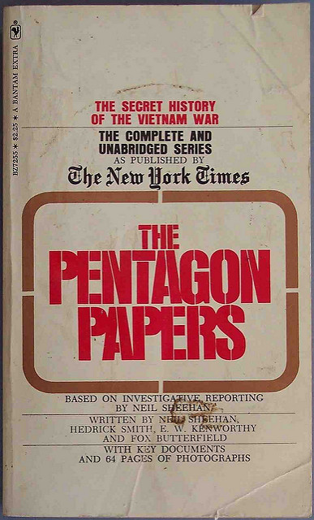
NY Times v. U.S
“Pentagon Papers Case”

Slide 2
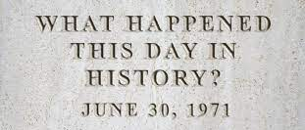
General Information
“Pentagon Papers” Case
Argued: June 26, 1971
Decided: June 30, 1971
Chief Justice: Warren E. Burger
Involves first amendment
“Congress shall make no law . . . abridging the freedom of speech, or of the press”

Slide 3
Background
US involvement in Vietnam War → increasing importance of security and secrecy
Government enforced Espionage Act → crime to obtain information about US national defense with the attempt to use it to hurt the country
Crime to not tell such information to a government agent
Sometimes used against people speaking out against government actions
Constitutional questions:
What happens when laws intended to protect American security interests clash with the First Amendment right to freedom of press?
How many power does the government have to prevent the media from publishing sensitive information?

Slide 4
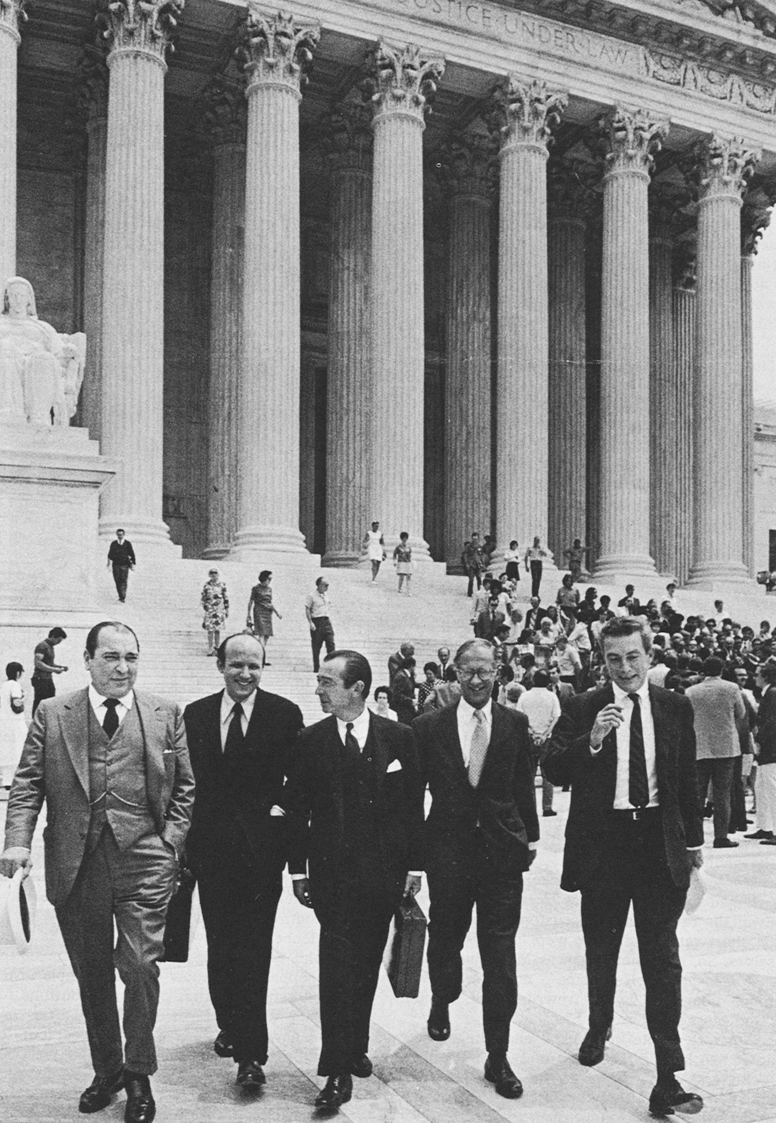
Facts
Daniel Ellsberg opposed US involvement in the Vietnam War → illegally copied 7,000+ pages of classified reports (“Pentagon Papers”) kept at the RAND Corporation
Pages told of U.S.’s plans of intervening in Vietnam conflict and President Lyndon Johnson’s true motives in Southeast Asia → leaked to major publications
NY Times reporter Neil Sheehan published some stories → President Nixon tried to stop further publications (unsuccessful efforts)
“irreparable injury to the defense interests of the US”
Notes:
He worked at RAND Corporation
Leaked to NY Times, The Washington Post
The president’s words contradicted true intentions

Slide 5
Facts
US government sued NY Times for violating Espionage Act
The Washington Post published stories about the papers
Both newspaper companies said they had the right to publish → 1st Amendment
Court of Appeals for D.C. Circuit and for Second Circuit had differing rulings
Supreme Court combined the cases
General issue: Did the government’s efforts to prevent two newspapers from publishing classified information given to them by a government leaker violate the First Amendment protection of freedom of the press?
Notes:
Rulings → one favored gov ad one favored post (newspaper)
SC agreed

Slide 6
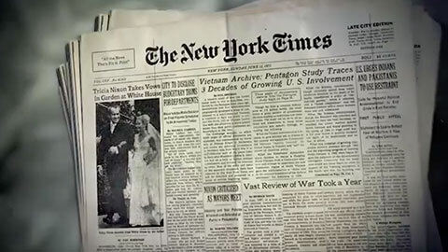

Slide 7
Why did it go to the Supreme Court?
The Solicitor General, Erwin Griswold, requested to take the case.
After the Second Circuit Court of Appeals affirmed, NY Times made an emergency appeal to the Supreme Court.
Concerns about national security → leading to a restraining order preventing further publication of the papers
Forced to stop publications after the government won a temporary court ordered ban.
Did the Nixon administration’s efforts to prevent publication of what it termed “classified information” violate the First Amendment?

Slide 8
Arguments
New York Times:
First Amendment→ press has protection to preserve democracy and serve the governed, not the government
Congress has made laws abridging freedom of press for national security reasons
Information was published to help the country by informing citizens about government actions
Government secrecy goes against democracy → publishing information reveals mistakes, misjudgements, etc.
US Government:
Executive branch should have broad authority during wartime to protect US security
The courts should not interfere with national security and foreign affairs
Constitution delegates those issues to executive and legislative branches
Separation of powers
The newspapers knew Pentagon Papers had illegally gained sensitive information
Citizen’s job to tell of possession of private government documents
Notes:
Reveals what people should know
Newspapers knew it went against the government and they should have figured the situation out with gov

Slide 9
Court Ruling
The Supreme Court ruled for NY Times that yes, “ the government did not overcome the ‘heavy presumption against’ prior restraint of the press in this case.” (Oyez) Black and Douglas both felt that “security” should not be used to discriminate the fundamental rights of the first amendment. Prior restraint was unjustified, even though the President argued otherwise, because publication would not cause an immediate threat to American forces.

Slide 10
Concurrences
Executive branch doesn’t have inherent power to protect national security
The government’s intent in confidentiality and secrecy has been recognized, but the executive branch is obligated to protect themselves
The First Amendment freedom of press is absolute → a court can never instruct the publication of news or media
Under no circumstances may the executive or judicial branch encourage publication of information on national security grounds, as neither branch has inherent power to do so

Slide 11
Dissents
Complaints that the Court had rushed it decision and that justices in the lower courts “do not know the facts” → facts are crucial because the First Amendment is not absolute (Justice Burger)
After accepting, hearing, and deciding the case in less than a week Justices Harlan, Burger, and Blackmun all felt that the court didn’t leave enough time to consider the “difficult questions of fact, law and judgement”
Justice Blackmun felt that the court only looked at the case in regards to the First amendment
Impact of right to publish is less significant as the court failed to produce a reason supporting the majority opinion

Slide 12
Analysis and Constitutional Significance
Seen as a seminal victory for free press in the US
Court held the government must meet various requirements of justification before it can restrain press from exercising First Amendment right
Supreme Court allowed Times to continue publication, supporting the right to publish
The decision allows the possibility of government censorship as it does not specify the conditions in which the First Amendment would permit it
The hesitant majority doesn’t agree that prior restraint may never be imposed → may be imposed if Congress provides authorization or if there is a serious threat to national security

Slide 13
Precedents
Near v. Minnesota
J.M. Near published The Saturday Press in Minnesota → controversial newspaper
Minnesota’s law prohibits scandalous, defamatory, or malicious newspapers
Near sued by someone targeted by the paper
Court said state was infringing on First Amendment
Applied freedom of press to states and said prior restraint unconstitutional
Dennis v. United States
Involved members of American Communist Party
Upheld Smith Act → crime for a person or group to advocate or support advocacy of violently overthrowing the government
Court said speech bringing protection harm to country’s security is not protected under First Amendment
Notes:
The Saturday press offensive

Slide 14
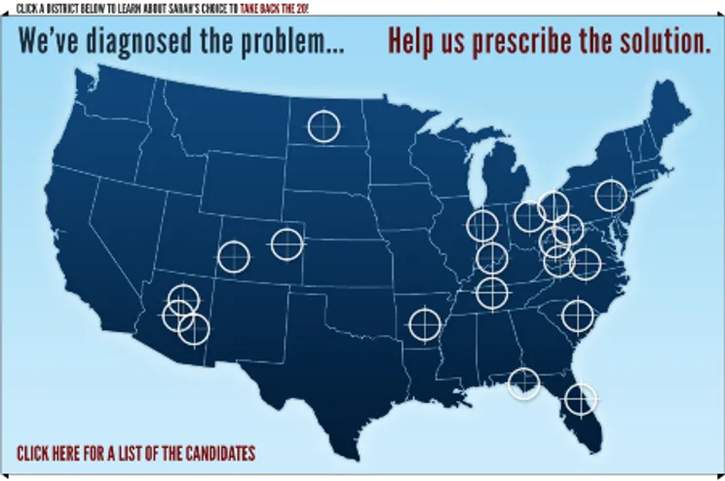
Sarah Palin v. New York Times
After a shooting in 2011 leaving congressmen injured, New York times editorial mentioned a map created by Sarah Palin’s committee that “superimposed the image of a crosshairs target over certain Democratic congressional districts” → This suggests a link between the map and the shooting. Palin filed a defamation action against Times.
Did the district court err in dismissing Palin’s complaint? - Yes - The court relied on outside information to dismiss the complaint, but found that the complaint was valid. She argument stated a claim for defamation by a public figure and the disputed statement concerned her and was made with malice.

Slide 15
Hazelwood School District v. Kuhlmeier
Argued: October 13, 1987
Decided: January 13, 1988
Chief: William Rehnquist

Slide 16
Facts
Hazelwood East High School’s sponsored newspaper, The Spectrum, written and edited by students
Principal found two articles about teen pregnancy and divorce to be inappropriate → wanted to withhold from publication
Cathy Kuhlmeier and other students argued First Amendment
U.S. District Court: school had authority to remove articles written in class
U.S. Court of Appeals: paper is a “public forum” extending beyond school and can only be censored for extremities
Went to Supreme Court
Question: Did the principal's deletion of the articles violate the students’ rights under the First Amendment?

Slide 17
Constitutional Similarities & Historical Significance
Similarities:
Both cases deal with First Amendment freedom of speech and press
Different scenarios surrounding publication → differing results regarding exercising freedoms
Significance:
First Amendment student free speech cases widely discussed→ less students filed lawsuits against school censorship after decision
Questions over how the case fits or doesnt fit First Amendment precedents
Tinker v. des Moines and NY Times v. US
Notes:
Censorship was a hot topic at the time but after the case there wasnt much else done with it
Tinker v. moines precedent → schools cannot limit free speech unless it affects educational process f
What else do I write for both of these things?

Slide 18
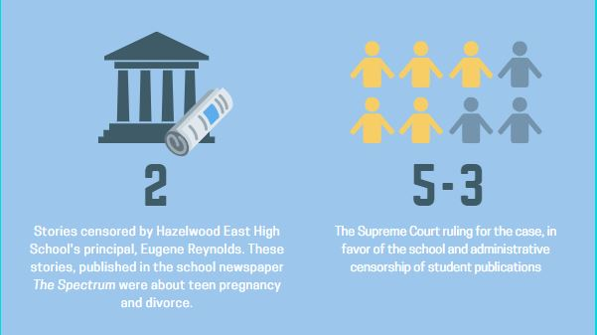
Ruling
5-3 ruling: did not violate students’ freedom of speech rights
Paper sponsored by the school → school has ability to prevent the publishing of inappropriate articles that could paint the school in a bad light
Paper not meant to be a public forum → written for journalism class
Schools can regulate speech as long as it is “reasonably related to legitimate pedagogical concerns” → protect schools image and “basic educational mission”
Judge Byron White
First Amendment rights of students in public schools “are not automatically coextensive with the rights of adults in other settings”
Judge William Brennan’s dissent
First Amendment does not allow “such blanket censorship authority”
Notes:
Not a public forum for people to share views → written for class and must meet class requirements and guidelines
Quote part → schools can regulate as long as that is the case (reasonable concerns and not unreasonable censorship)

Slide 19
Analysis
Paper was not a public forum → did not have to follow Tinker v. Moines precedent
First Amendment does not require schools to promote particular types of student speech
Created a new standard for school-sponsored student speech v. student-initiated speech
Schools can also regulate speech interfering with rights of other students and speech with bias, inadequate research, vulgarity and profanity, or unsuitable information for the audience

Slide 20
Greater New Orleans Broadcasting Association, Inc. v. United States
Argued: April 27, 1999
Decided: June14, 1999
Chief: William Rehnquist

Slide 21
Facts
Greater New Orleans Broadcasting Association wanted to run advertisements for private casino gambling in a state where it was legal
Association challenged government’s prohibition of radio and television advertising for private commercial casino gambling
Trial and appellate courts ruled in favor of government → Supreme Court granted them certiorari
Constitutional Question: Does a federal prohibition against advertising lawful, private casino gambling violate the First Amendment’s freedom of speech protections?

Slide 22
Constitutional Similarities & Historical Significance
Similarities:
Involves First Amendment → freedom of speech and freedom of press
The government failed to demonstrate that the advertising restrictions were constitutional
Significance:
Censorship viewed as restriction to democracy → seen in NY Times v. US
Reinforces government will not allow censorship unless absolutely necessary in the situation
Upholds Central Hudson Test from a previous ruling

Slide 23
Ruling
Unanimous court decision → advertising restrictions placed deemed unconstitutional
Utilized test for assessing commercial speech restrictions from Central Hudson Gas & Elc. Corp v. Public Service Commission of NY
Is speech at question concerning a lawful activity? Is it misleading?
Are government interests substantial?
Does the regulation advance government interests?
Is the regulation necessary or extensive?
Judges agreed Association’s speech constitutes commercial speech
No misleading information and concerns lawful activities

Slide 24
Analysis
Court stated the government could not prove why restriction would decrease harmful gambling practices
Regulation did not do much to help with government’s concerns regarding gambling
Government restrictions unfairly placed restrictions on one specific form of freedom of speech
Ruling continued trend of protecting commercial speech by striking down the advertisement law for violating First Amendment

Slide 25
Interactive
Discussion Post Question - What authority do you feel the courts have to interfere with national security and/or foreign affairs? It is considered censorship if its protecting national security? Do you believe freedom of speech should be absolute?
Notes:
https://padlet.com/22aroraa/NYtimesvUS

Slide 26
Citations
Sources for NY Times vs. US

